Slide 1
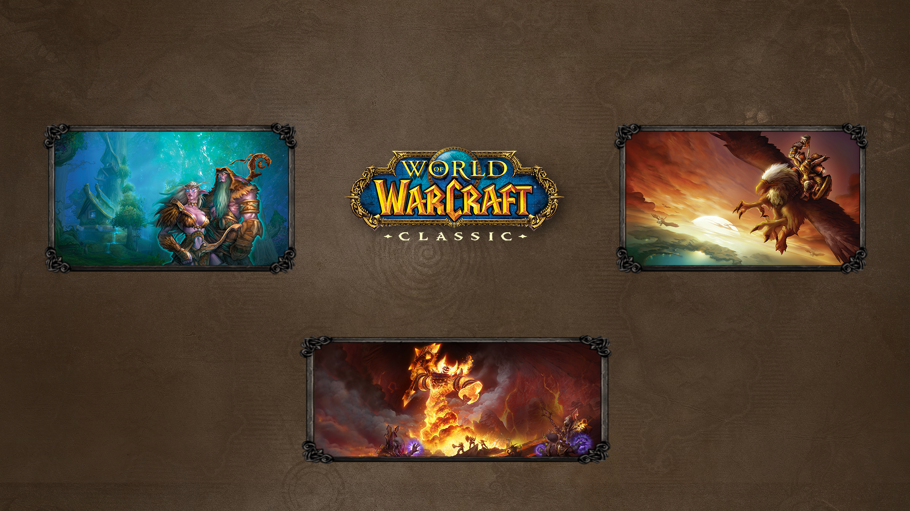
Auction House Price Prediction
Nikolai Alexander – CSCI4502
nial3328@colorado.edu

Slide 2

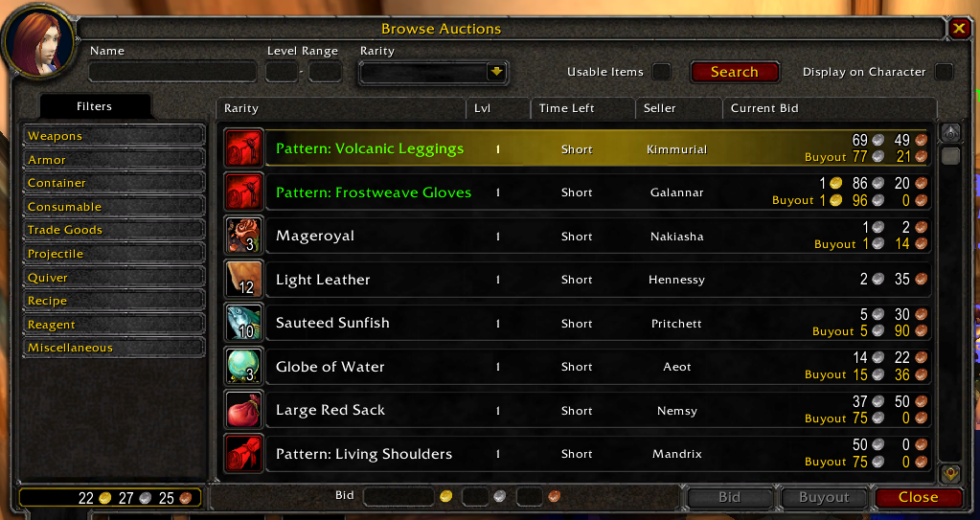
What is the Auction House?
A faction-wide trading hub for players to buy/sell items obtained in the game
Seller set bid & buyout prices on the item postings, and compete to have their items sold
Buyers can choose to pay the buyout price to get the item instantly, or bid against other buyers in hopes of getting a lower price.

Slide 3

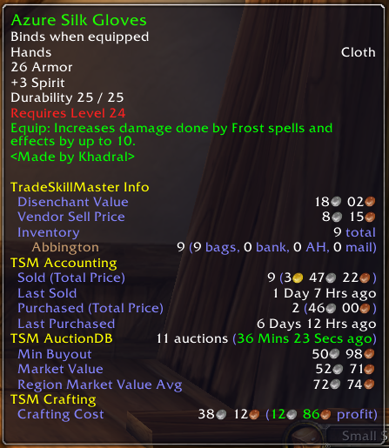
Predicting Price Fluctuations
Competitive pricing leads to fluctuations in the in game “economy”
Similar to how the NYSE behaves
Many different factors can affect price
Supply vs. Demand
Relevance to In-Game Content
Market Control from high value players

Slide 4

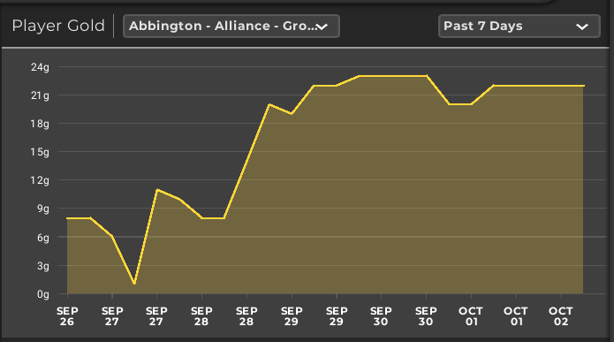
Why is this Interesting?
Deeper understanding of in-game economies
Find parallels with the real-world economy
Understand what types of items have a higher volatility than others

Slide 5
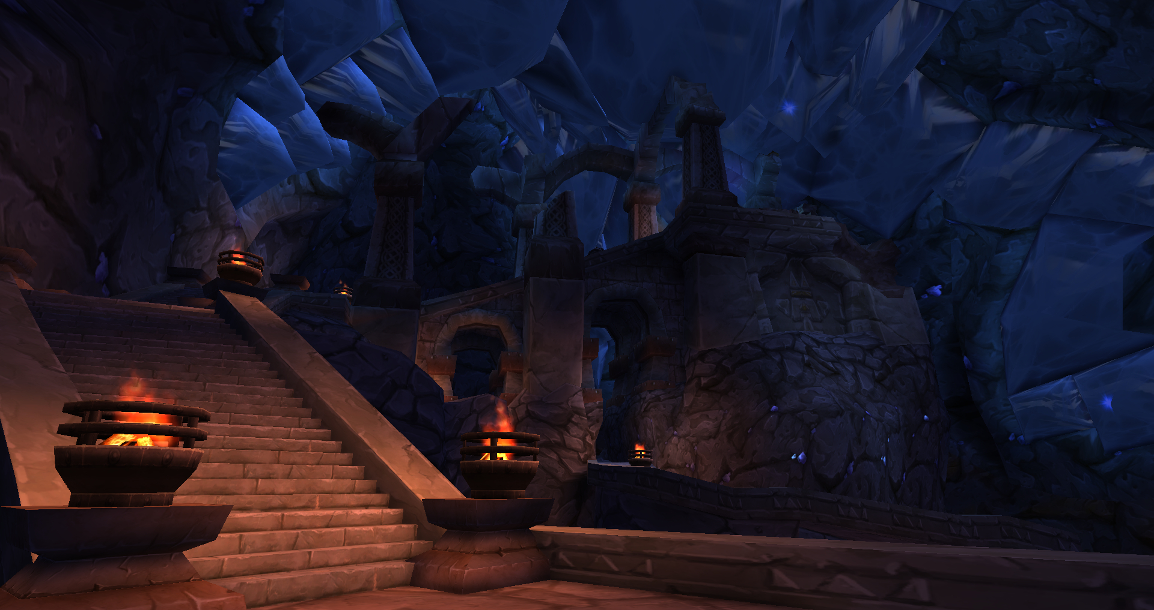
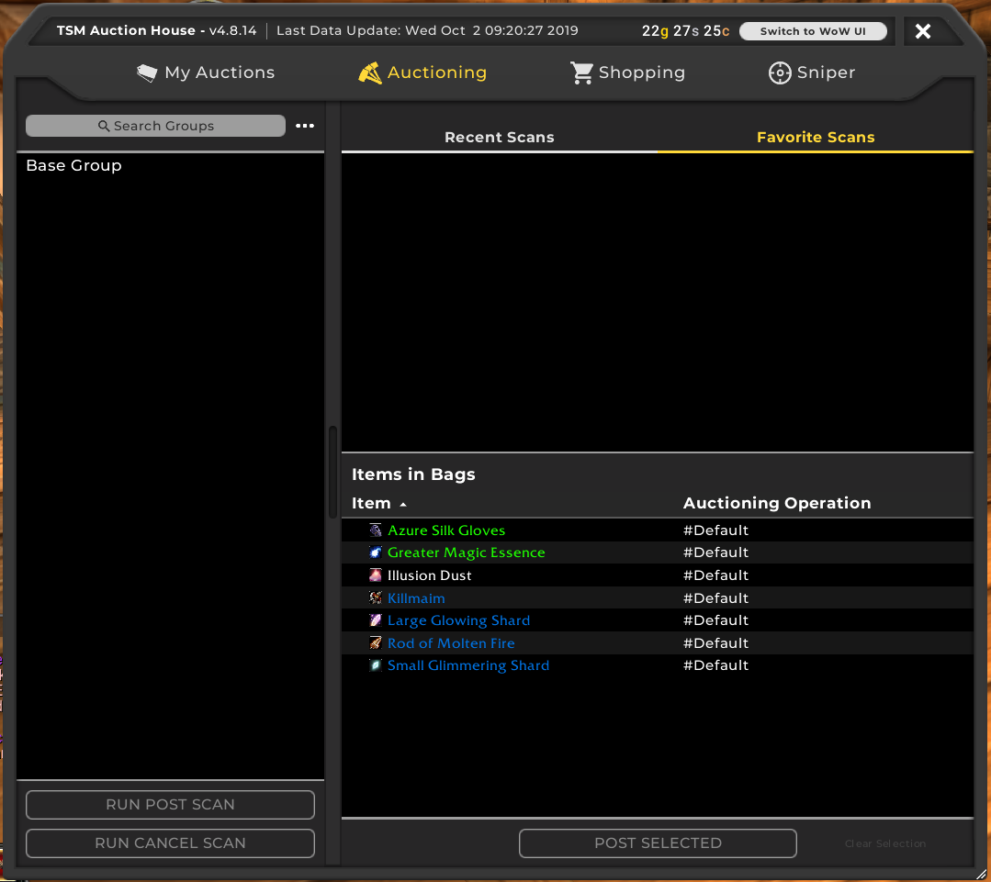
Prior Work – TradeSkillMaster (TSM)
TradeSkillMaster is an independent modification approved by Blizzard Entertainment used for tracking Auction House Data
Scans the Auction House and calculates market price & minimum buyout price
Does not store past data
No future price prediction

Slide 6

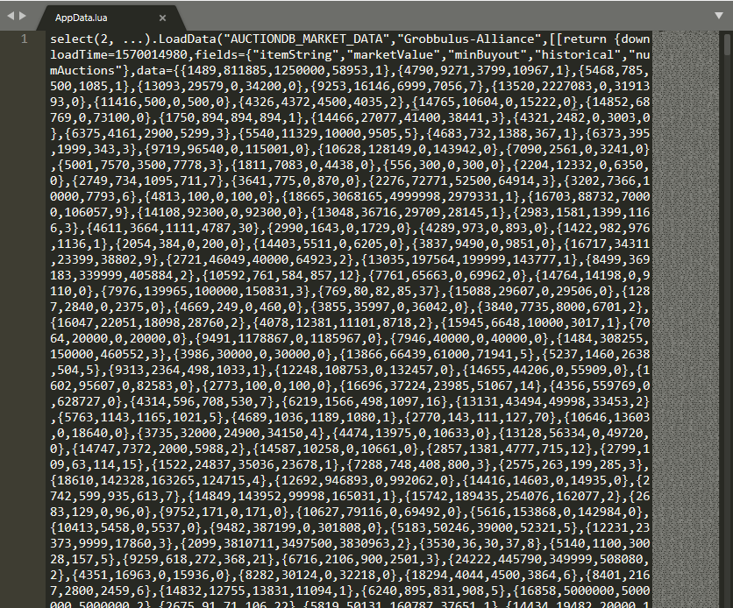
Approach & Tasks
Develop script to automatically mine & store TSM data file every time there is an update
Store in SQL DB or CSV file
Mine WoWhead DB (Using Web Scraping) to collect all data on all items
Develop Python Dash App to visualize data in real-time
Use Machine Learning to predict future price fluctuations

Slide 7
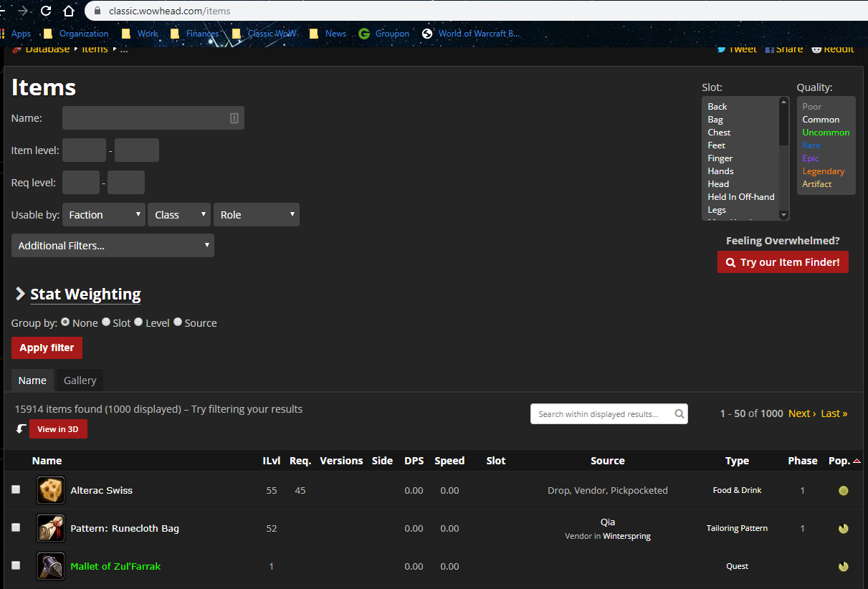
Obtaining the Data & Challenges
Blizzard does not have a public API
TSM relies on player scans of AH
Need to collect data from TSM LUA data folders manually (Can use an automated script on a server)
For static data (item stats, Non-player character price), need to web scrape WoWHead.com

Slide 8

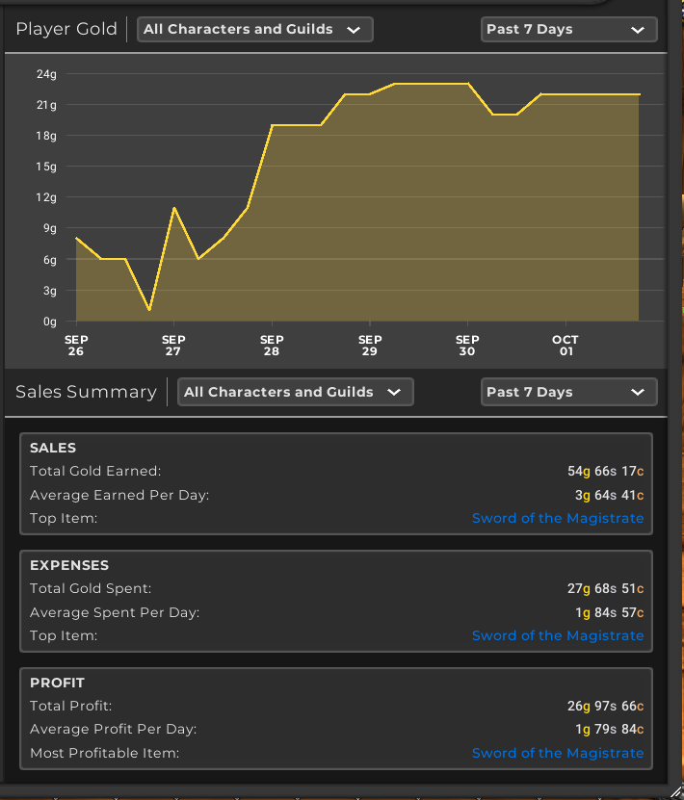
Evaluation
I am going to evaluate my work by how well my strategy performs with the WoW Economy
TSM keeps a log of portfolio performance dating back to 1 year
The rate of growth of my portfolio determines how effective my strategy is.

Slide 9

Timeline
Complete TSM data mining script and have it up and running on a server – Oct 15
Mine all WoW Classic Item Data from WoWHead – Oct 31
Collect 1 month’s worth of TSM data (~480 scans) – Nov 15
Deploy Dash App (Privately) – Nov 30
Tentative – Build Machine Learning Algorithm to Predict Future Pricing – Dec 10

